Slide 1
KNS INSTITUTE OF TECHNOLOGY Image Speech Recognization Using Generative AI And LLM
Under the guidance of
Dr. Arun Kumar L
Prof, Dept of AIML
Presented by
Achyuth C R Banish Gowda D S Jagannath Varun S
1KN21AI001 1KN21AI004 1KN21AI013 1KN21AI048

Slide 2
CONTENTS
Abstract
Introduction
Literature Survey
Block Diagram
Hardware/Software Description
Methodology
Flowchart
Code & Output
Implementation
Results and Future Scope
Conclusion
References

Slide 3
Abstract
The project "Image-to-Story-to-Speech Generation Using LLM" creates an AI system that transforms images into engaging audio stories. It uses the BLIP model for image captioning, GPT-3.5-turbo (via LangChain) for generating short, imaginative stories, and the ESPnet VITS model for speech synthesis. A user-friendly Streamlit interface allows users to upload an image and receive both a written story and audio narration. This system demonstrates the integration of computer vision, NLP, and speech synthesis, with applications in education, accessibility, and entertainment.

Slide 4
Introduction
The project "Image-to-Story-to-Speech Generation Using LLM" combines AI models to create a seamless process that converts an image into a narrated story.
It uses the BLIP model for image captioning, GPT-3.5 for story generation, and the ESPnet VITS model for text-to-speech conversion.
The goal is to emulate human storytelling by interpreting visual inputs and transforming them into engaging audio output.
This system merges computer vision, natural language processing, and speech synthesis, showcasing the power of multimodal AI.
Users can upload an image and instantly receive both a written story and a narrated version, making it accessible and interactive.
Applications include education, assistive technology for the visually impaired, and content creation for social media and entertainment.
Built with Streamlit, the system offers a simple, real-time, and user-friendly interface for seamless interaction.

Slide 5
Literature Survey
.
Sl no | title | Published year | Authors | Key findings | Gaps identifed
01 | Coherent Visual Storytelling via Parallel Top-Down Visual and Topic Attention | 2023 | Jinjing Gu, Hanli Wang, Ruichao Fan | Proposed a topic-aware visual storytelling model | Does not support real-time or on-device processing.
02 | “Visual Storytelling with Large Language Models” | 2021 | A. Radford, J. Wu, R. Child, D. | Demonstrates the potential of GPT-3 in generating coherent, context-rich narratives from structured and visual inputs. | Not focused on multi-modal alignment or real-time deployment

Slide 6
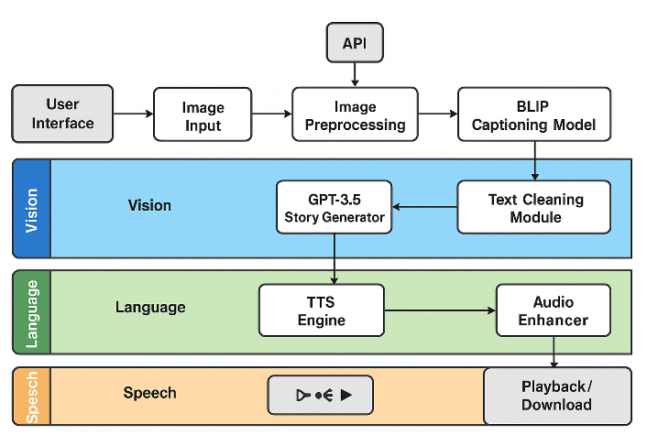
Block Diagram

Slide 7
Explaniation
Image Analysis & Caption Generation
The BLIP model converts visual content into a textual caption by using its encoder-decoder architecture. The encoder captures spatial and semantic features, while the decoder generates a human-readable description.
LLM-Based Story Synthesis
The caption is fed into GPT-3.5-turbo via LangChain for story generation. The LLM expands the caption into a rich, creative short story, maintaining context and coherence.
Text Normalization
The generated story is refined to improve speech synthesis. This step handles abbreviations, numerals, punctuation, and prosody markers to ensure better intelligibility and natural speech.
Text-to-Speech Conversion
The ESPnet VITS model converts the refined text into high-quality, expressive speech using variational inference and adversarial training, producing audio that can be streamed or saved.
Audio Output Layer
The system integrates with Streamlit to play the generated speech and provides an option for users to download the audio, offering a smooth and user-friendly experience from input to output.

Slide 8
Hardware Description
Hardware:
CPU: High-performance processor (e.g., Intel i7, AMD Ryzen 7) for managing tasks.
GPU: Powerful GPU (e.g., NVIDIA RTX 3060/3070) for deep learning model acceleration.
RAM: 16GB-32GB RAM for efficient multitasking and processing large models.
Storage: Fast SSD (512GB or more) for quick data and model loading.
Audio Output: Quality speakers or headphones for clear, natural speech playback.
Networking: Stable internet for cloud models, APIs, and data access.
UI: Display to interact with the Streamlit interface for image upload and audio playback.

Slide 9
Software Description
Software:
BLIP Model: Converts images to descriptive captions.
GPT-3.5: Generates creative stories from captions.
ESPnet VITS: Converts text to high-quality speech.
LangChain: Manages GPT-3.5 prompt engineering for story generation.
Streamlit: Builds user-friendly interface for real-time interaction.
Python Libraries: torch, transformers, pydub for model and audio processing.
Cloud Services (Optional): AWS/Google Cloud for heavy computation tasks.

Slide 10
Methodology
Image Analysis & Caption Generation:
The BLIP model generates a descriptive caption from the input image, summarizing visual content.
Story Generation using GPT-3.5:
The caption is used as a prompt for GPT-3.5 (via LangChain) to create a short, imaginative story.
Text Normalization:
The story is refined by handling abbreviations, punctuation, and prosody markers to prepare for natural speech.
Text-to-Speech Conversion:
The refined text is converted to expressive speech using the ESPnet VITS model.
Audio Output:
The synthesized speech is played through Streamlit, allowing users to listen to or download the audio.

Slide 11
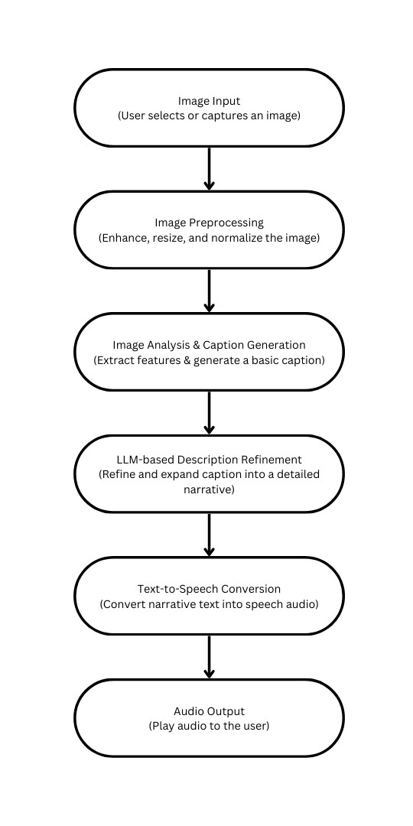
Flow Chart
Image Input User selects or captures an image.
Preprocessing Image is enhanced, resized, and normalized.
Caption Generation Features extracted, basic caption created.
LLM Refinement Caption expanded into a detailed narrative.
Text-to-Speech Narrative converted to speech.
Audio Output Speech is played to the user.

Slide 12
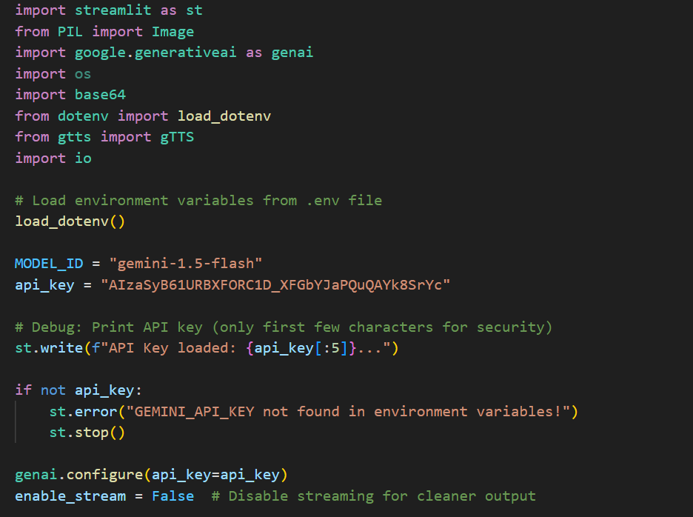
Code

Slide 13
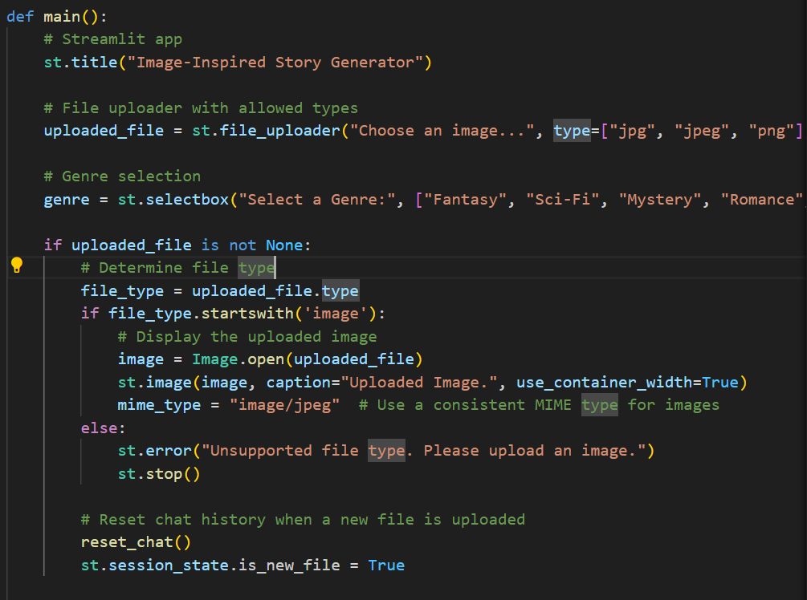
Code

Slide 14
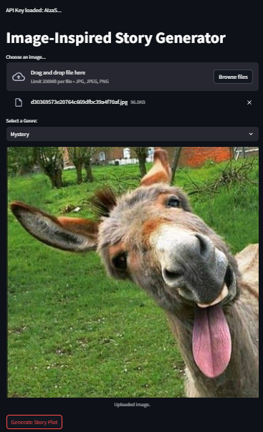
Input

Slide 15
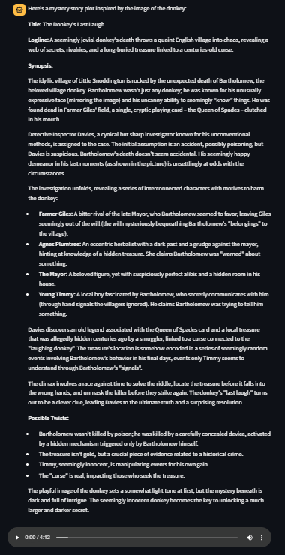
Output

Slide 16
Result
The system converts input images into engaging short stories and natural-sounding speech.
Uses BLIP for image captioning, GPT-3.5 for story generation, and ESPnet VITS for speech synthesis.
Users receive both readable text and streamable/downloadable audio.
Delivers fluent, context-aware storytelling with high accuracy.
Simple Streamlit interface ensures smooth user interaction and real-time output.
Demonstrates a successful integration of computer vision, NLP, and TTS technologies.

Slide 17
Future Scope
Multilingual support to generate stories in regional and global languages.
Emotion-aware TTS for expressive and context-sensitive narration.
Mobile and offline deployment for accessibility and assistive tools.
Custom storytelling styles like poetic, humorous, or dramatic modes.
Real-time generation from live camera input for interactive use.
Integration with advanced models (e.g., vision transformers) for better scene understanding.
Embedding in education platforms and virtual assistants for wider applications.

Slide 18
Conclusion
The “Image-to-Story-to-Speech Generation Using LLM” project presents an innovative and interactive AI system that transforms static images into narrated stories. By integrating BLIP for image captioning, GPT-3.5/4 for story creation, and ESPnet VITS for speech synthesis, the system offers a seamless and engaging multimedia experience. It enhances how users interact with visual content and holds strong potential in assistive technologies, education, and entertainment. The project highlights the power of combining computer vision, language generation, and speech synthesis, paving the way for more intelligent and human-like AI applications in the future.

Slide 19
References
[1] Vinyals, K., Toshev, A., Bengio, S., & Erhan, D. (2015). Image Captioning with Deep Learning. Proceedings of NeurIPS.
[2] Radford, A., Wu, J., Child, R., Luan, D., Amodei, D., & Sutskever, I. (2021). Visual Storytelling with Large Language Models. OpenAI Blog.
[3] Wang, Y., Skerry-Ryan, R., Garofalo, D. W., Radford, A., & Amodei, D. (2018). End-to-End Text-to-Speech with Deep Learning Models. IEEE Transactions on Audio, Speech, and Language Processing.
[4] Li, J., Zhang, X., Lan, X., Yu, J., & Feng, J. (2022). BLIP: Bootstrapping Language-Image Pretraining for Image Captioning. In Proceedings of the IEEE/CVF Conference on Computer Vision and Pattern Recognition (CVPR).
[5] Roberts, D., Velloso, G. R. S., Meneguzzi, E., & Eger, M. H. S. (2021). Interactive Storytelling through AI: A Review of Narrative Generation Techniques. ACM Computing Surveys.
[6] Salesforce Research, “BLIP Model Implementation,” GitHub,2022.[Online].Available:https://github.com/salesforce/BLIP
[7] Google Developers, “gTTS: Google Text-to-Speech API forPython,” Available: https://pypi.org/project/gTTS/

